Slide 1
Plant Disease Detection
Sazid Alam – 1511394042

Slide 2
Introduction
Pattern recognition can be used in many aspects of agriculture, one of which is Plant disease detection.
Image and pattern recognition techniques are applied to a dataset of images of a large variety of plants to train them to identify if a plant is diseased and if it is, to specify its disease.
Creation and implementation of such a model and subsequent release to those in the industry will allow those in the agricultural sector, particularly low income farmers to quickly and easily identify plant diseases before they are advanced and will allow them to seek a cure before the disease spreads to the rest of the harvest resulting in higher output of healthy crops.

Slide 3
Dataset
The dataset we have chosen to use for our project is the Plant Village dataset
14 types of plant & 38 classes
Initially working on 6 types of plant & 16 classes
  Apple
  Blueberry
  Cherry
  Corn
  Grape
  Orange

Slide 4
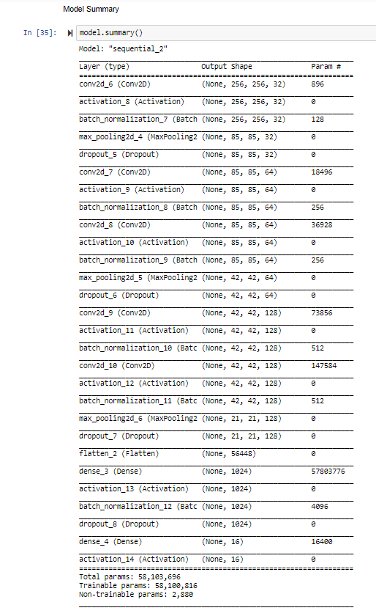
Models
There are two main types of models available in Keras: the Sequential model, and the Model class used with the functional API.
For this project Keras Sequential Model has been used.

Slide 5
Algorithm
Convolutional neural network (CNN)
  A convolutional neural network (CNN, or ConvNet) is a class of deep neural networks, most commonly applied to analyzing visual imagery.
  They are also known as shift invariant or space invariant artificial neural networks (SIANN), based on their shared-weights architecture and translation invariance characteristics.
  They have applications in image and video recognition, recommender systems, image classification, medical image analysis, and natural language processing.

Slide 6
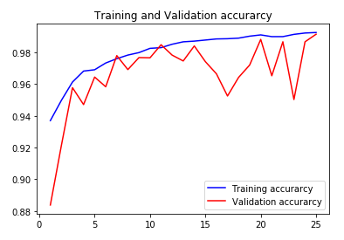
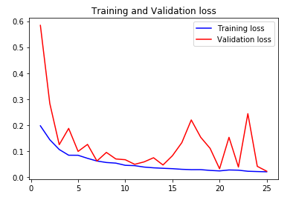
Result
Training and Validation accuracy
Training and Validation loss

Slide 7
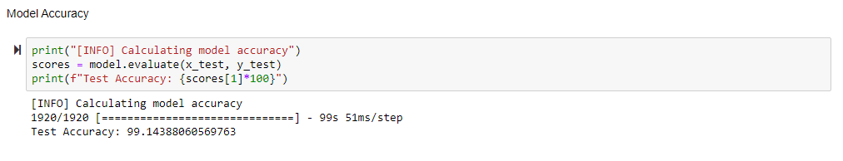
Result
  Final accuracy of the model is 99.14%
  Model was trained for 25 epochs.

Slide 8
Thank You

